Slide 1


LOCAMONDA
Modern Property Rental & Real Estate Platform
Graduation Project / Software Engineering Capstone
Presented by:
Elamir Mohamed Elfoly
Asma Mohamed Abdallah
Aya Mohamed Rayan
Basant Farag Mokhtar
Tasneem Mohamed Eid

Slide 2


COMPREHENSIVE PROJECT OVERVIEW
Centralized Real Estate Hub
Streamlined Experience
Locamonda is a full-featured web application designed to simplify property discovery, booking, and management through a single, secure unified ecosystem.
From finding a dream home to automated approvals, the platform bridges the gap between property owners and seekers with zero friction.
Automated Management
Equipping owners and administrators with powerful digital tools to manage portfolios, track bookings, and ensure data integrity in real-time.

Slide 3


THE PROBLEM STATEMENT
Fragmented Marketplaces: Listings are scattered across outdated platforms.
Manual Processes: Paper-based bookings are prone to errors and delays.
Lack of Trust: Inefficient communication leads to transparency issues.
Legacy Systems: Poor user experiences hinder modern digital adoption.

Slide 4
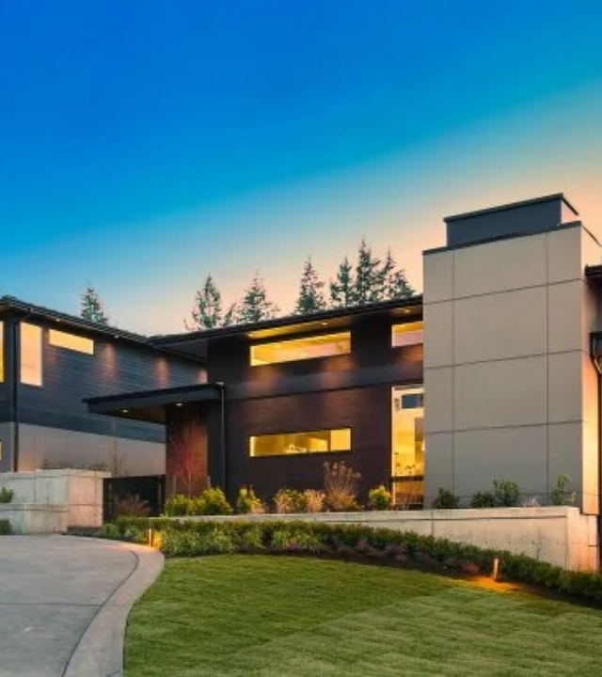
THE LOCAMONDA SOLUTION
Digital Transformation
We digitize the entire rental lifecycle—from discovery to final approval. Our platform ensures trust through transparency and efficiency through automation.
Unified Digital Ecosystem
Automated Approval Workflows
Real-Time Communication

Slide 5






KEY PROJECT OBJECTIVES
Efficiency
Security
UI
Scalability
Maximize operational speed for both renters and landlords.
Ensure high-grade data integrity and user privacy.
Deliver an intuitive interface with a premium digital feel.
Build a robust architecture ready for future market growth.

Slide 6









OUR TARGET AUDIENCE
Seekers
Owners
Admins
Users looking to rent or buy homes safely.
Landlords seeking tools to manage their assets.
Governing the platform and resolving disputes.

Slide 7






ESSENTIAL SYSTEM FEATURES
Advanced Search
HD Galleries
Integrated Chat
Wishlists
High-resolution visuals to enhance decision making.
Save and track favorite properties seamlessly.
Dynamic filtering for precise location and price matches.
Indirect communication between owners and tenants.

Slide 8
USER ROLES & PERMISSIONS
User Role | Core Permissions | Primary Dashboard Tools
System Admin | Full System Control & Governance | User Mgmt, Reports, Site Settings
Property Owner | List Management & Bookings | Property CRUD, Approval Workflow
Seeker / Tenant | Discovery & Reservation Requests | Profile, Favorites, Message History
*Strict Role-Based Access Control (RBAC) ensures data security across all levels.

Slide 9
MODERN TECHNOLOGY STACK
Backend Infrastructure
Frontend Standards
ASP.NET Core MVC (C#)
HTML5 & Tailwind CSS
SQL Server / EF Core
JavaScript & DOM Manipulation
ASP.NET Core Identity
Leveraging the power of the Microsoft .NET ecosystem for high performance.

Slide 10
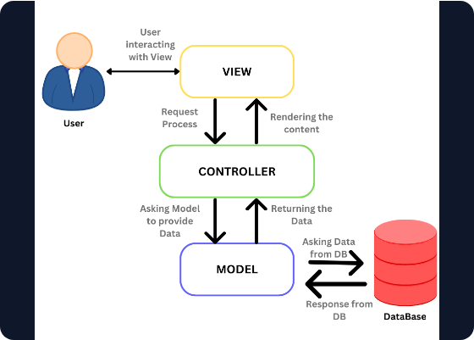
ASP.NET CORE MVC ARCHITECTURE
Model: Represents data structures and business logic.
View: Responsible for UI presentation via Razor Pages.
Controller: Handles requests, routing, and logic flow.
Dependency Injection: Built-in support for loosely coupled services.

Slide 11


DATABASE DESIGN & STRUCTURE
Entity Framework Core
Utilizing a Code-First Approach, our database schema was generated directly from C# domain models.
Relational Integrity
Auto-Generated Migrations
Core Entities: Users, Properties, Bookings

Slide 12
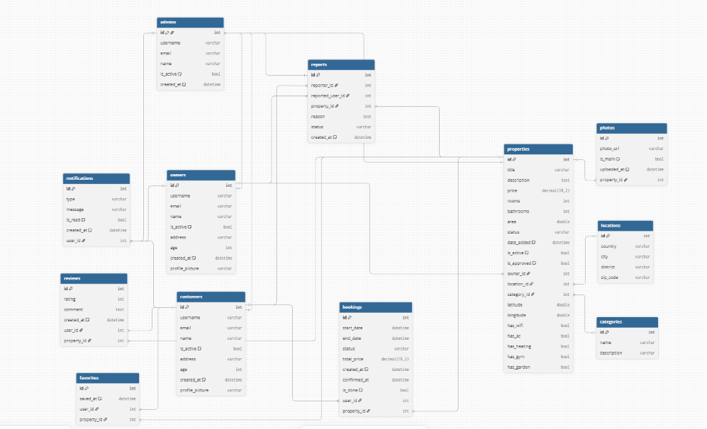
ERD

Slide 13
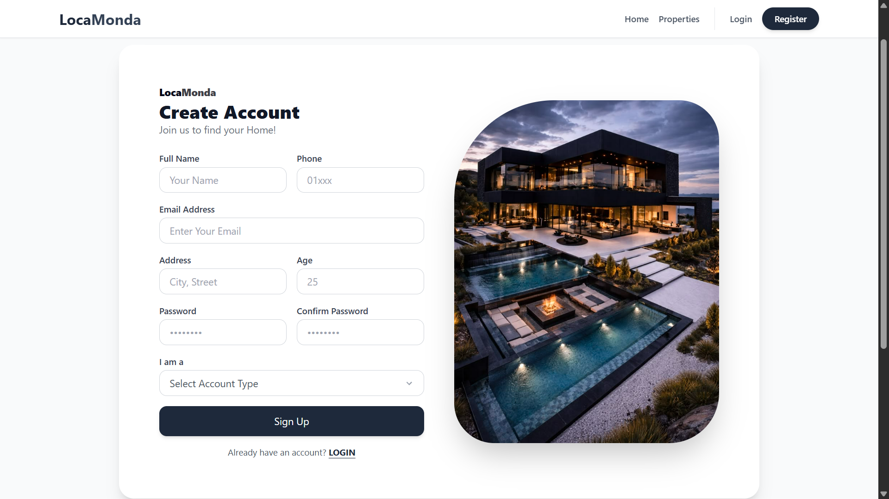
AUTHENTICATION & SECURITY
100%
Secure Identity Framework
ASP.NET Core Identity
Industry-Standard Password Hashing
Claim-Based Authorization
Secure Session Management

Slide 14
PROPERTY MANAGEMENT WORKFLOW
Validation
Live Status
System performs automatic data checks.
Property becomes visible to all seekers.
Submission
Admin Review
Owner uploads property details & images.
Administrator verifies listing quality.

Slide 15

EFFICIENT BOOKING ENGINE
Real-Time Validation: Prevents double-bookings and date conflicts automatically.
Instant Notifications: Owners receive immediate alerts for new reservation requests.
Status Tracking: Clear visibility of Pending, Confirmed, and Cancelled bookings.
Agreement Flow: Digital handshake between tenant and landlord within the app.

Slide 16


ADMIN DASHBOARD & METRICS
Centralized Control
Live Reporting
A unified panel to oversee entire system health and user interactions across the platform.
Generate automated metrics on total properties, active users, and monthly booking trends.

Slide 17
SECURITY & DATA INTEGRITY
Dual-Layer Validation: Robust client-side and server-side input checks.
CSRF Protection: Integrated Anti-Forgery tokens for all form submissions.
SQLi Prevention: Parameterized queries enforced via Entity Framework Core.

Slide 18

DEVELOPMENT CHALLENGES
Technical Hurdles
Logic Complexity
Managing complex database migrations and asynchronous image storage required advanced problem-solving within the EF Core framework.
Developing conflict-free booking state management and ensuring UI/UX consistency across diverse user roles was a major focus area.

Slide 19
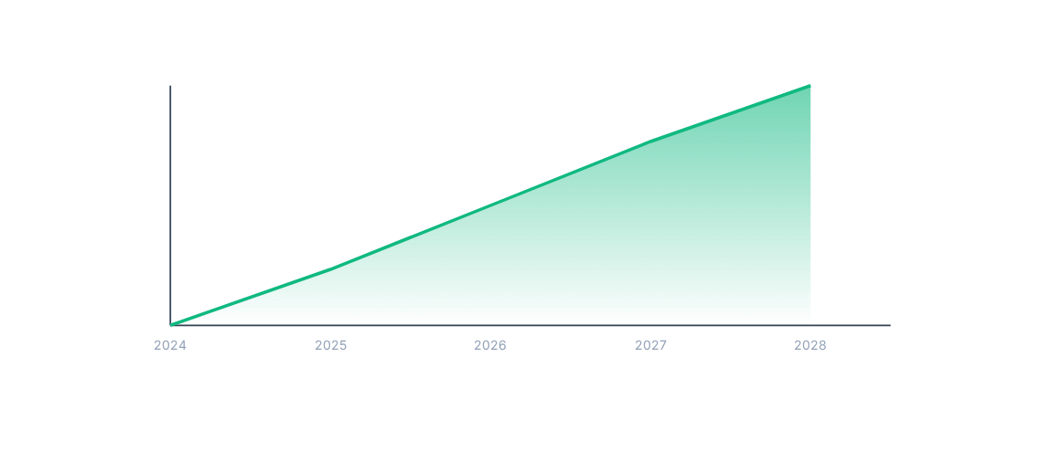
FUTURE ROADMAP & GROWTH
Upcoming: Payment Gateway Integration | AI Recommendations | Native Mobile Apps

Slide 20
Questions?
Thank you for your time and attention.
Locamonda: The Future of Real Estate
www.locamonda.com | info@locamonda.com

